Slide 1
Our Earth and our Solar system

Slide 2
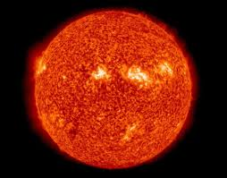
Stars
Heavenly bodies twinkle
Have their own light
Eg. Sun

Slide 3
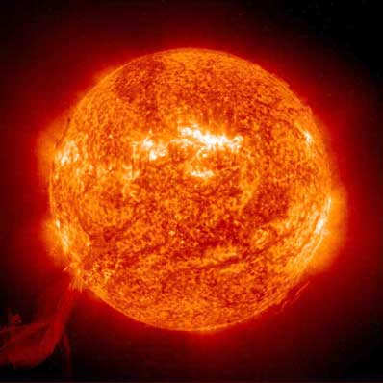
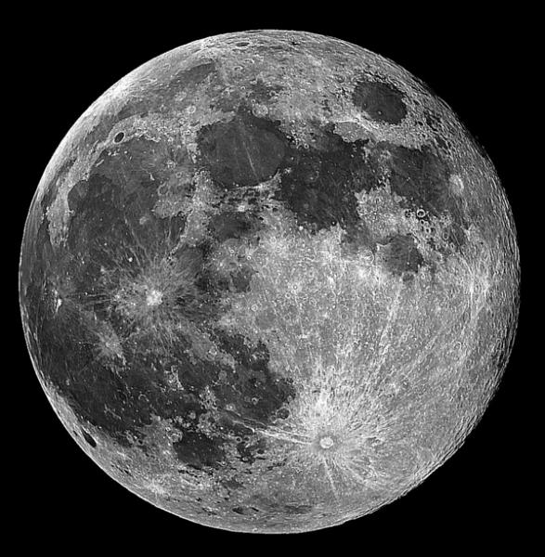
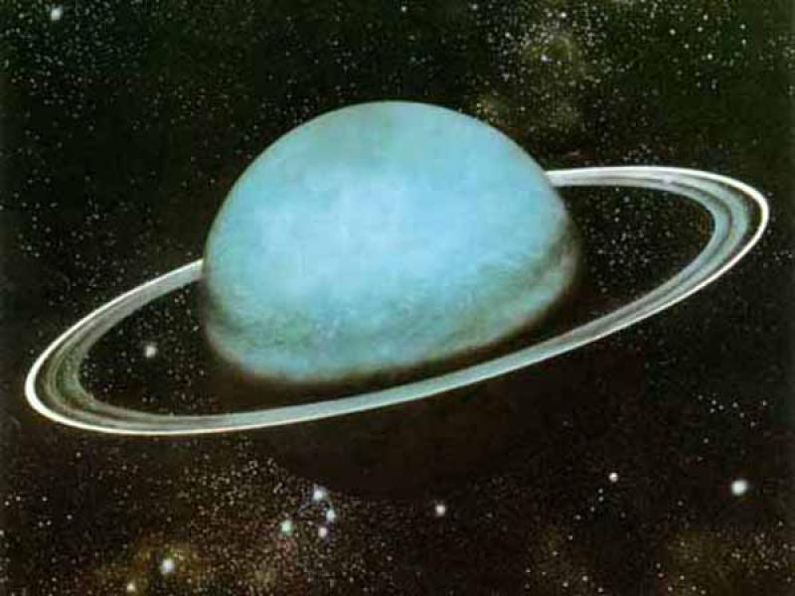
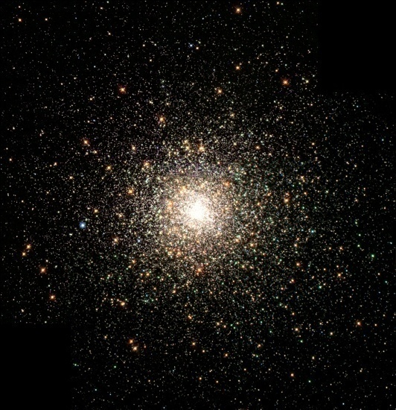
Planets
Do not twinkle
Do not have their own light
Get light from sun and star
Eg. Earth get light from sun

Slide 4
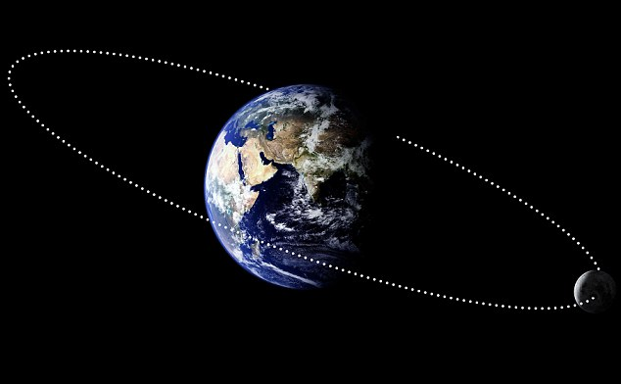
Satellites
Some heavenly bodies revolve around planet
Eg. Moon revolve around earth

Slide 5
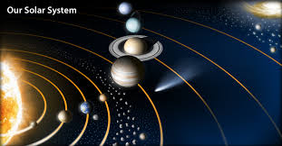
Solar system
Stars, Planets, Satellites all together called solar system.
Many solar system are there but we can see only one

Slide 6
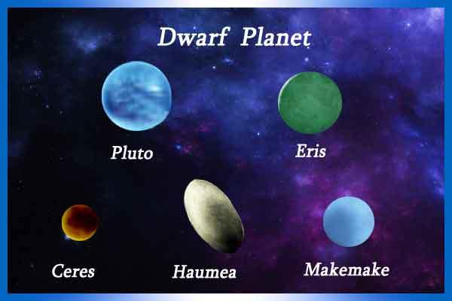
Dwarf Planets
Smaller heavenly bodies
Revolve independently around the sun
Have their own orbit

Slide 7
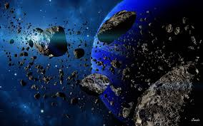
Asteroids
Smaller heavenly bodies
Revolve independently around the sun and have their own orbit
Between Mars and Jupiter numerous small heavenly bodies
Revolve around the Sun

Slide 8

Gravity
Heavenly bodies pull one another exert force of attraction
Sun exerts gravitational pull on planets at the same planets move away from Sun so planets revolve in a fixed distance in fix orbit

Slide 9
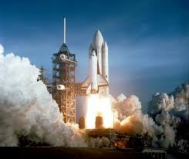
Space Launch
Due to gravity all things throw upwards down on the earth
Given power against the force of gravity
The emptiness between starts stars and planets is called Space.
Scientist who travel to space are called astronauts

Slide 10
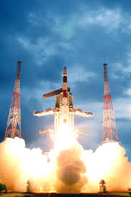
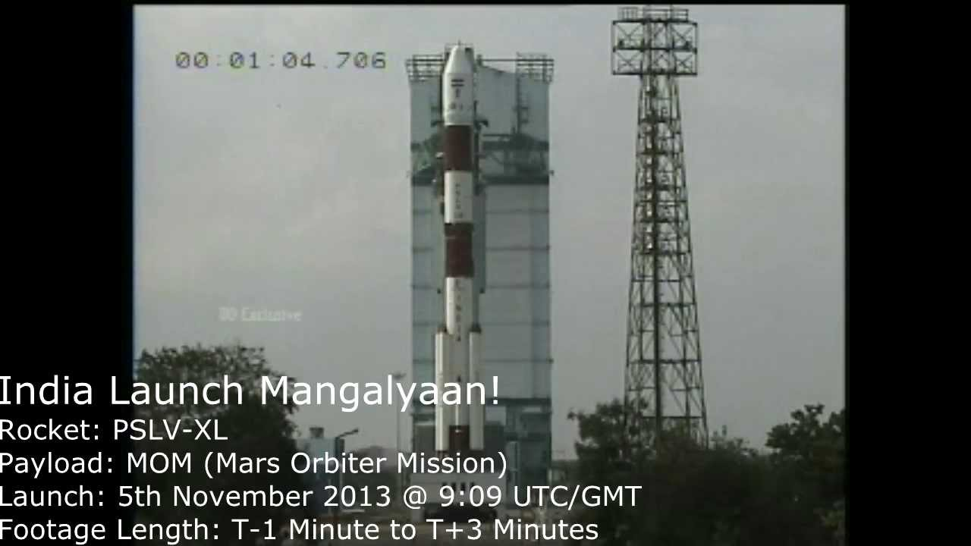
India’s Space Mission (ISRO)
Chandrayan 1 – 22 Oct 2008
Mangal Yaan – 5 Nov 2013
Proudest thing in the history of India

Slide 11

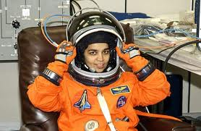
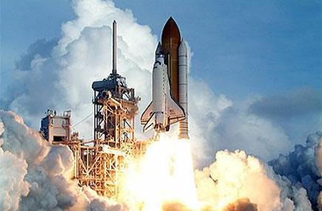
First Indian Astronaut
Rakesh Sharma – Space mission in 1984
Kalpana Chawala - First lady Indian astronaut.
2nd space mission in 16 Jan 2003

Slide 12
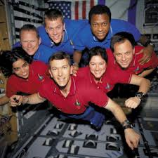
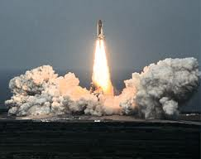
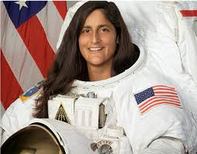
Columbia yaan space mission in 1997
Sunita Williams
2nd Indian woman

Slide 13
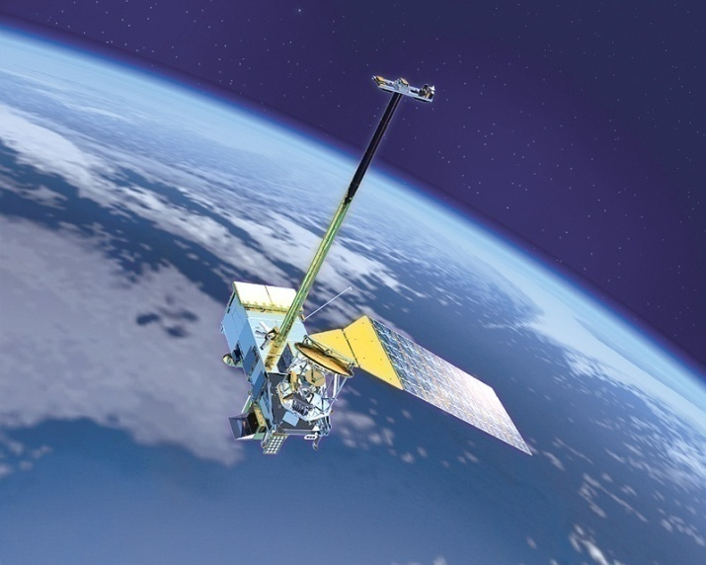
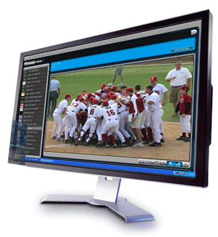
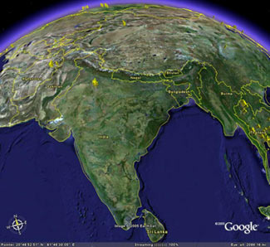
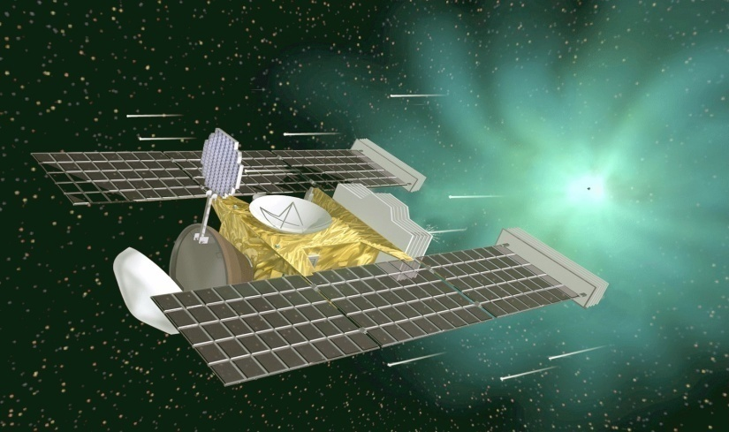
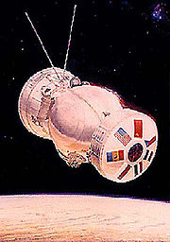
Study for the purpose
Agriculture, weather forecasting
Environment – searching for water
Making maps
Source of mineral wealth

Slide 14
Lets summaries
Sun is a star which has its own light.
All other bodies in solar system get light from the sun
The sun and planets, their satellites, dwarf planets and asteroids that revolve around the sun are together called solar system
Things on earth remain on it due to the force of gravity
To travel in space, the earth’s gravitational force has to be overcome. Rocket technology helps us do that.

